Slide 1
Precise Analysis

Slide 2
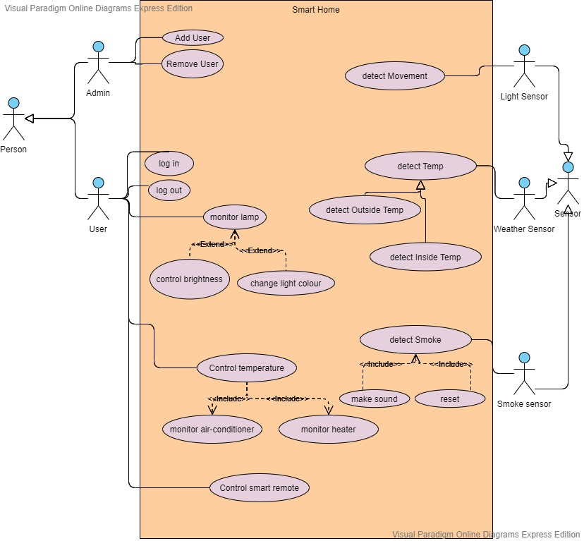
USE CASE DIAGRAM

Slide 3
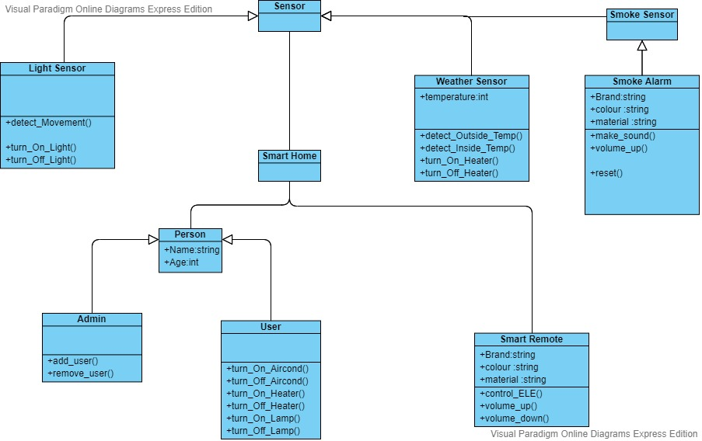
Class Diagram

Slide 4
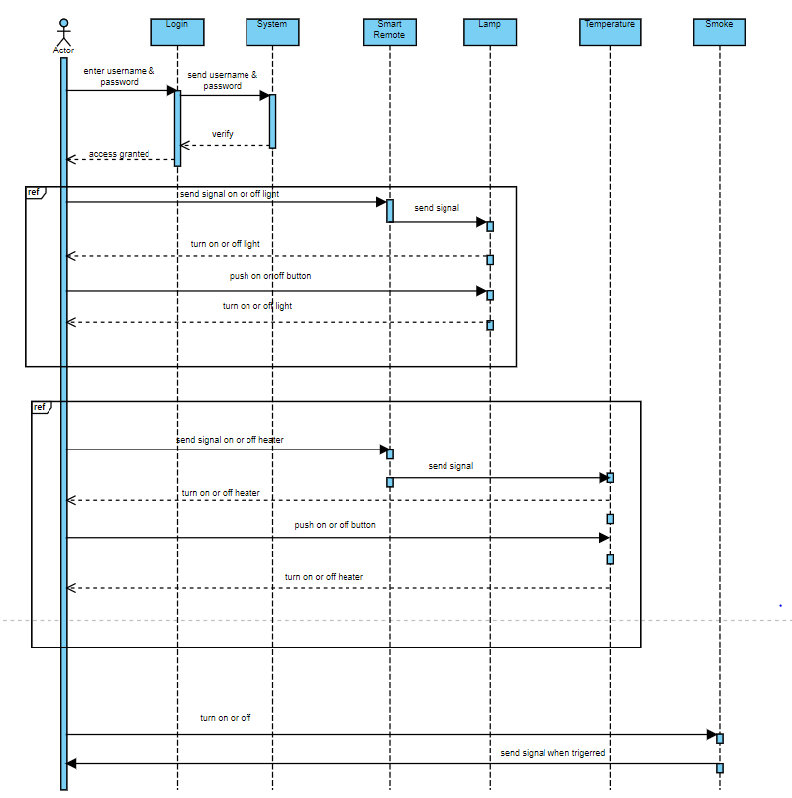
SEQEUNCE DIAGRAM FOR HOME APPLIANCES

Slide 5
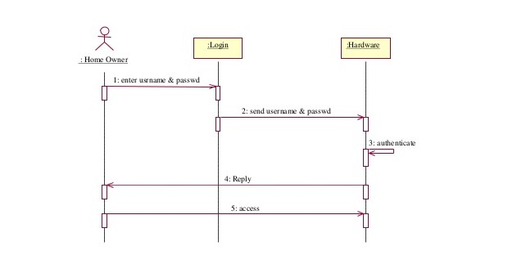
SEQUENCE DIAGRAM FOR LOGIN

Slide 6
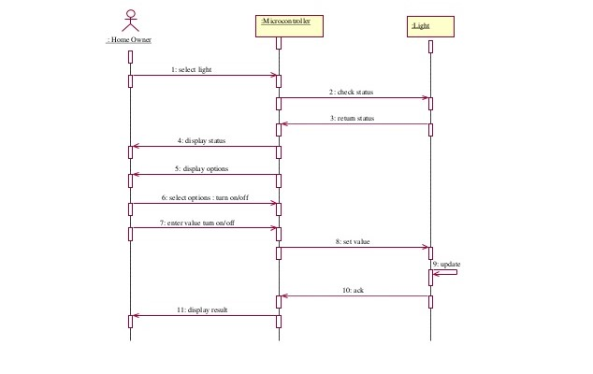
SEQUENCE DIAGRAM FOR CONTROLLING LIGHT

Slide 7
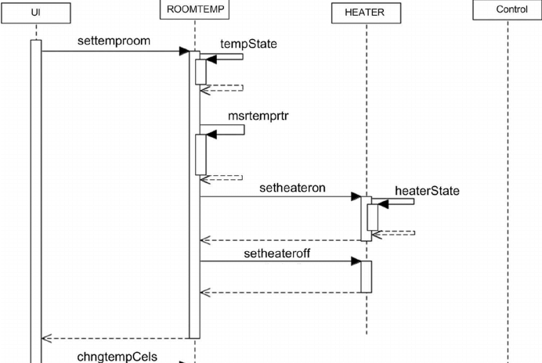
SEQUENCE DIAGRAM FOR HEATER

Slide 8
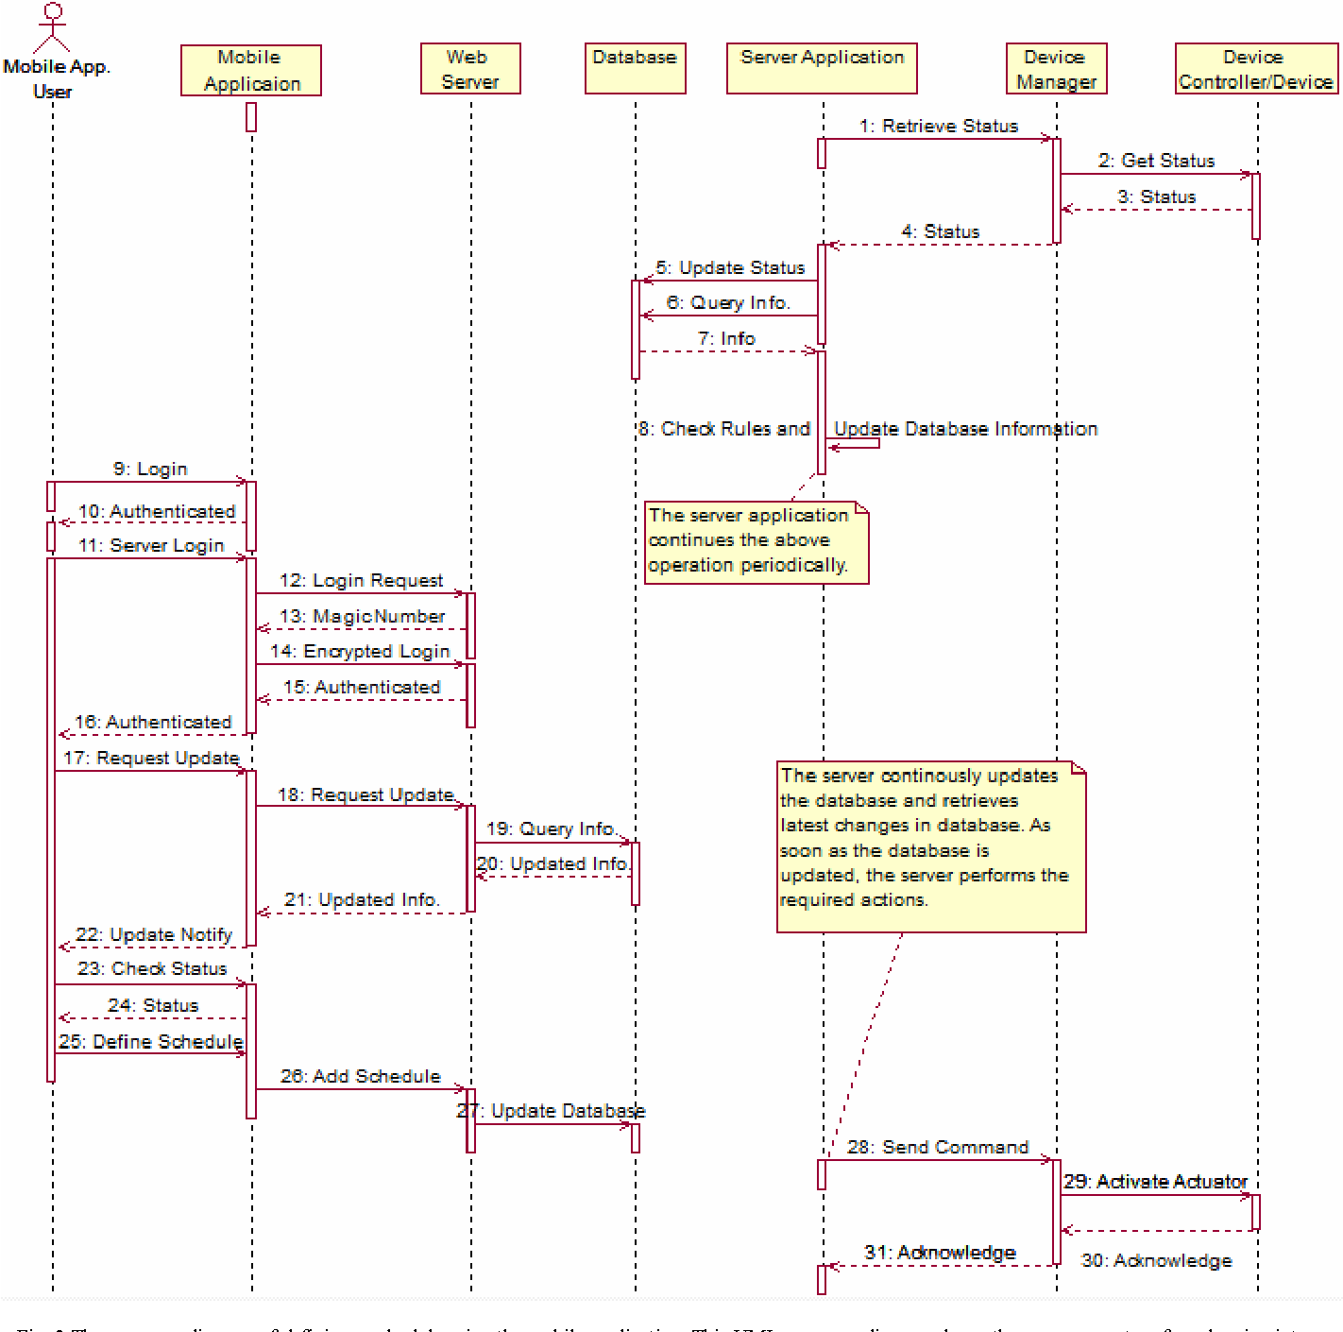
MORE GENERAL FORM

